Slide 1
Semester Two Exam Revision

Slide 2
EXAM STRUCTURE
3 hours + 10 mins reading time
3 sections
  Multiple choice
    30 questions, 30 marks, 30 %
  Short answer
    6 questions, 105 marks, 50%
  Extended response
    4 questions (answer 2), 40 marks, 20%

Slide 3
Tips for doing well!
Use reading time wisely by planning answers
Attempt all questions – leave it blank you will get zero but try and you might get it right!
Follow the instructions for each section
Write neatly
Use the time suggestions to pace yourself, make sure you attempt the whole paper and don’t run out of time.

Slide 4
What do I need to know?
EVERYTHING
Your exam will cover both Unit 1 & 2 content.
Use your syllabus document as a checklist when revising content.
Broad topics include:
- Scientific method - Biodiversity - Ecosystems
- Populations - Human Activity - Cells
- Exchange of materials - Cell processes - Multicellularity

Slide 5
Questions?
No, I can’t tell you exactly what is in the exam or the answers.

Slide 6
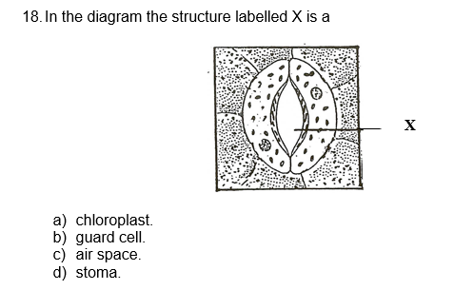
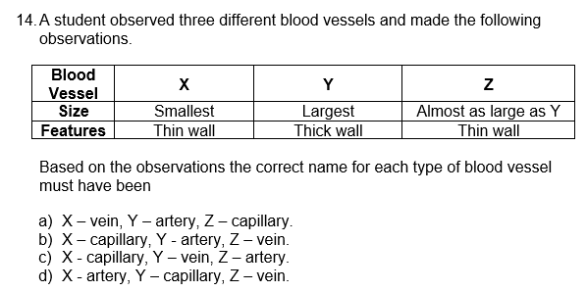
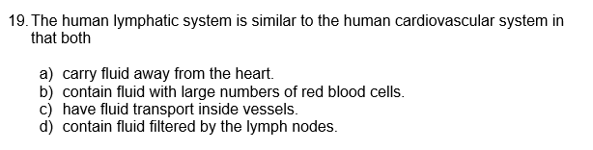
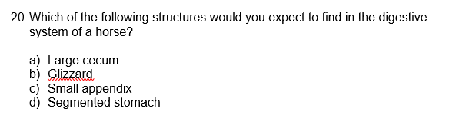
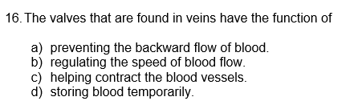
Notes:
18. D 14. B 19. C 20. A 16. A

Slide 7
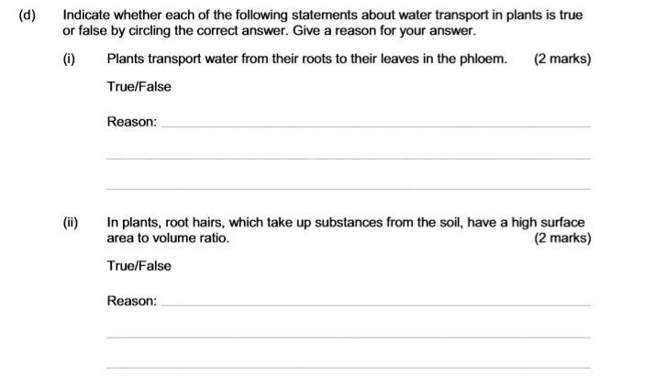
Notes:
(d) (i) False - Water travels to the leaves in the xylem/the phloem transport sugars not water.
(d) (ii) True - A high surface area to volume ratio maximizes substance uptake.

Slide 8
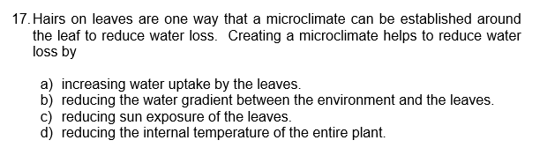
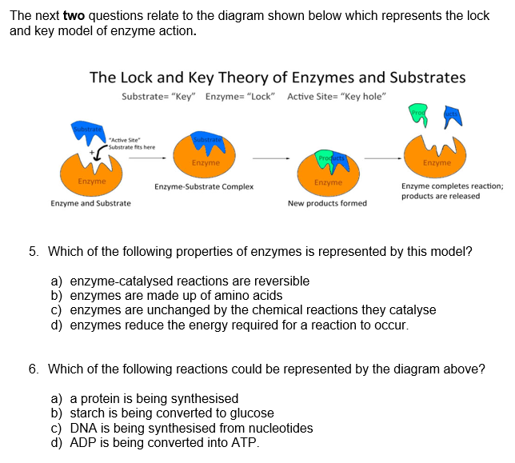
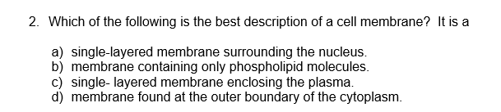
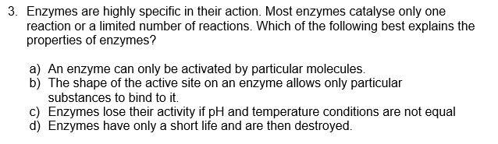
Notes:
17. B 2. D 3. B 5. C 6. B

Slide 9
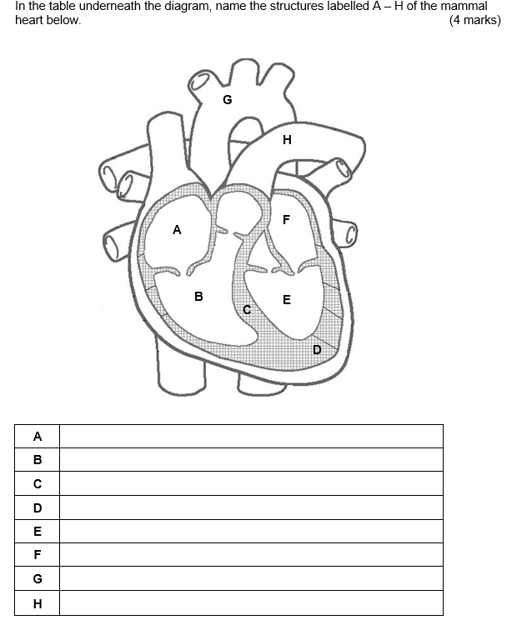
Notes:
A Right atrium B Right ventricle C Septum D Apex E Left ventricle F Left atrium G Aorta (arch) H Pulmonary artery
E – Left ventricle muscular wall is thick as it needs to work hard to pump oxygenated blood to the whole body.

Slide 10
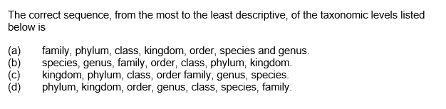
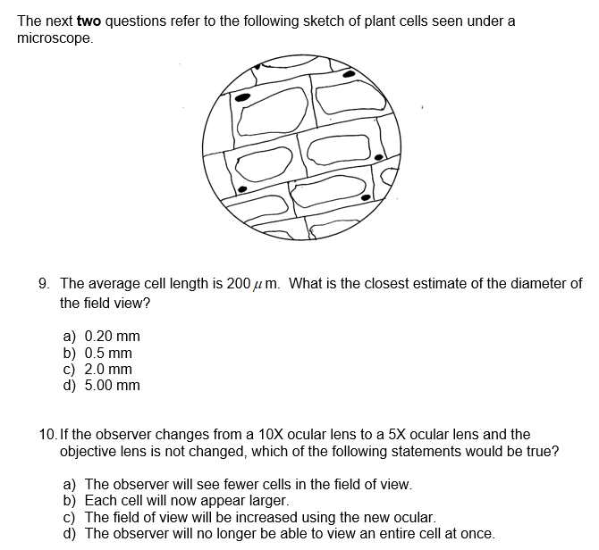
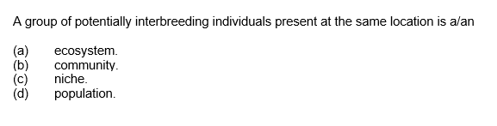
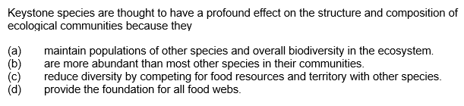
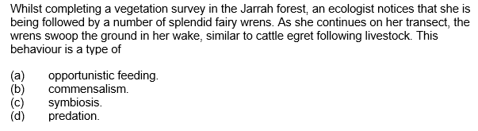
Notes:
9. B 10. C B D A B

Slide 11
Lesson 2…

Slide 12
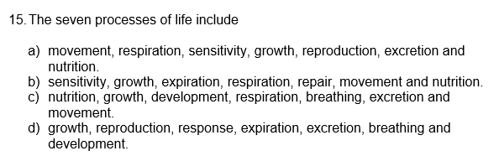
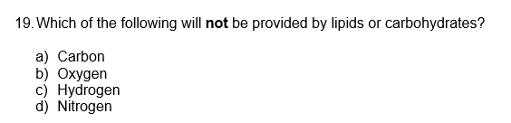
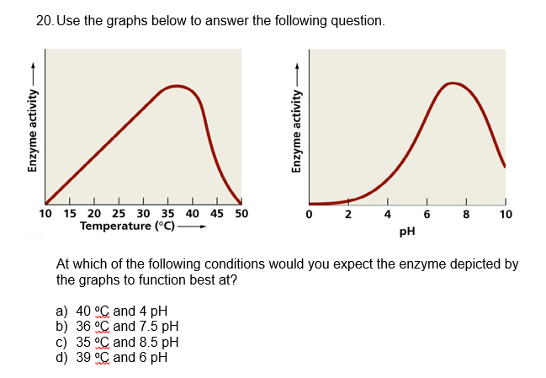
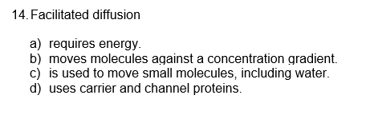
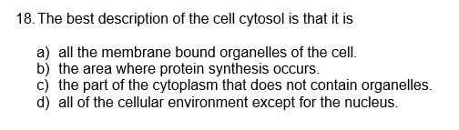
Notes:
15. A 14. D 18. C 19. D 20. B

Slide 13

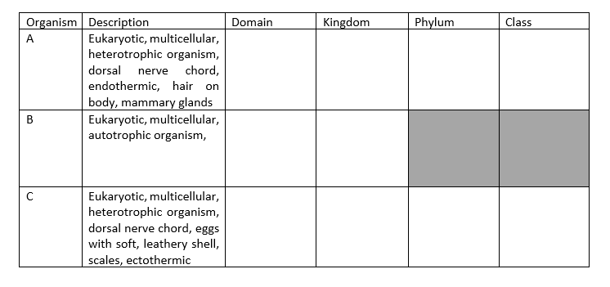
Notes:
Dichotomous keys are a tool used for identification of organisms based on physical characteristics.
Phylogenetic trees show evolutionary relationships between organisms.
Intraspecific - same species and interspecific -different species
Competing for limiting resources e.g. light, food, mates, nutrients
Organisms of the same species will have more similar requirements than those of different species. Same optimal range= competing for same resources
A: Eukarya, Animalia, Chordata, Mammalia
B: Eukarya, Plantae
C: Eukarya, Animalia, Chordata, Reptilia

Slide 14
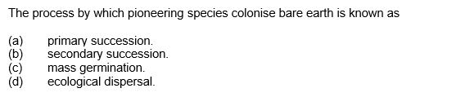
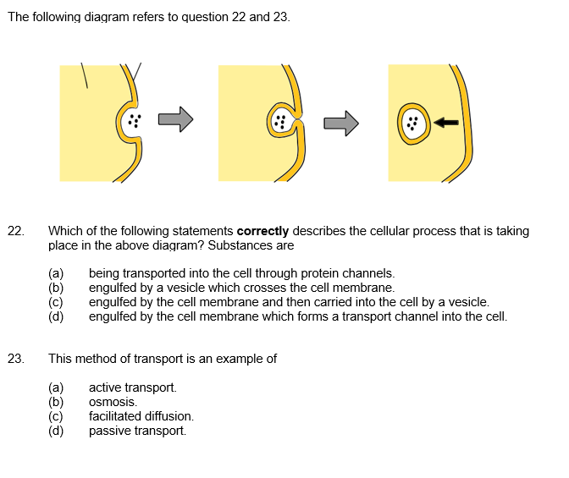
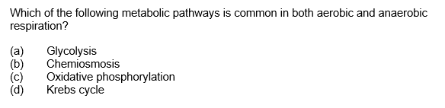
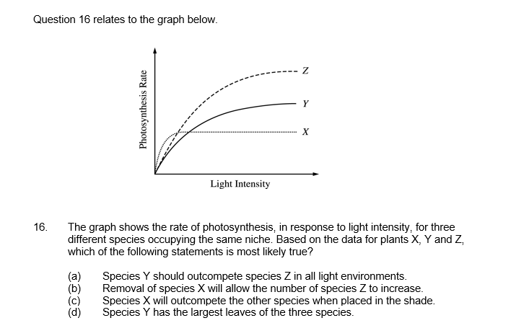
Notes:
22. C 23. A A A 16. C

Slide 15

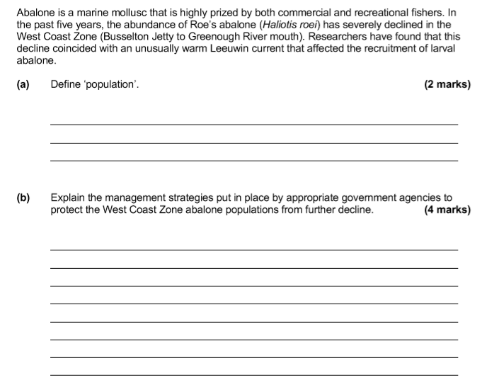
Notes:
Nitrogen cycle: Nitrogen fixation (1); Nitrogen gas (N₂) from the atmosphere is converted to ammonia (NH₃) (1); by nitrogen-fixing bacteria (1)
Carbon cycle: Photosynthesis (1); Carbon dioxide (CO₂) from the atmosphere is converted to glucose (1); By plants (1)
(a) Population = A group of individuals from the same species, living in the same area at the same time.
(b) License required for abalone capture. License restricts person to restricted area.
Restricted season (and limited time for ‘fishing’).
Bag limit (15 per person).
Size limit (must be ‘adult’ size, reproductive age).

Slide 16
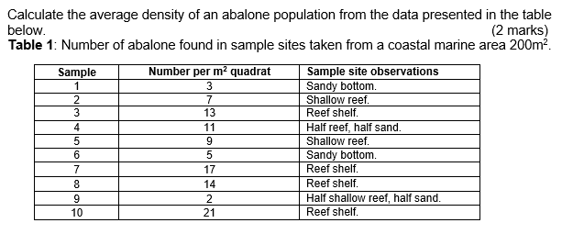
Notes:
(a) Formula: Total number in all quadrats sampled
Density = Number of quadrats x area of a quadrat
Calculation/answer:
102 / (10 x 1) = 10.2 individuals per m²
(b) 10.2 x 200 = 2040

Slide 17
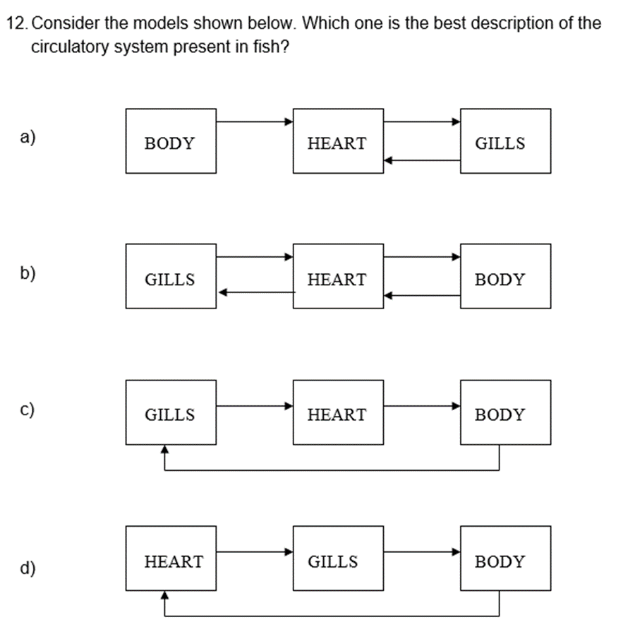
Notes:
12. D

Slide 18
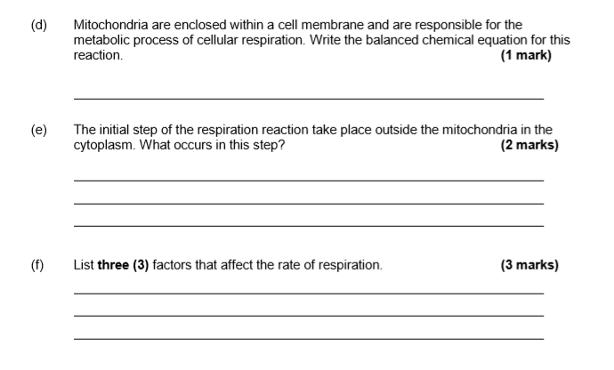
Notes:
(d) C₆H₁₂O₆ + 6O₂ → 6CO₂ + 6H₂O + 36 or 38ATP (1)
(e) Glycolysis- 1 Glucose is broken down into 2 pyruvate (1) & 2 ATP molecules produced (1)
(f) 1 mark per factor. Any 3 of: Temperature (1); pH (1); Concentration of glucose (1); Concentration of oxygen (1)

Slide 19
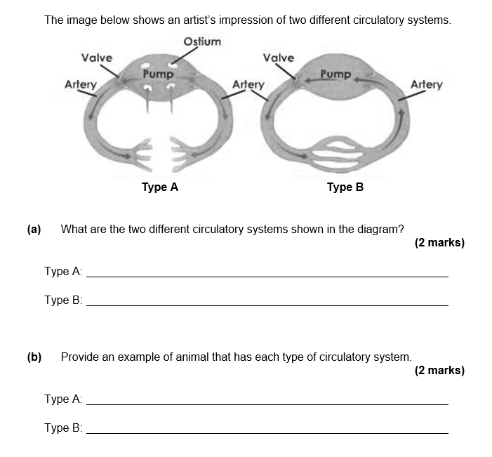
Notes:
(a) Type A: Open circulatory system (1) Type B: Closed circulatory system (1)
(b) Type A: Cricket (or other acceptable answer: Invertebrates usually have open with some exceptions (eg., crabs) – arthropods, molluscs, flatworms.) (1)
Type B: Earthworm (or other acceptable answer: most vertebrates have closed circulation – fish, frogs, mammals, birds.) (1)

Slide 20
Returning Your SIDE Resources
Please return your resources to SIDE as soon as you have finished with them for the year. This includes SIDE library books, text books, equipment and any unused materials.
HOW TO RETURN RESOURCES
OPTION 1: Post resources back to us – ask your parent or SIDE Supervisor for help. See postal addresses below. OPTION 2: Bring your resources with you if you are visiting Perth and drop them off in person. (Mon-Fri 8am-4pm)
SCHOOL BASED & HOME BASED IN AUSTRALIA Use the free reply-paid postal address: School of Isolated and Distance Education Attn: Library Resource Centre Reply Paid 455 LEEDERVILLE WA 6903 | HOME BASED OVERSEAS Please contact library@side.wa.edu.au to organise alternative arrangements if returning by postage is not possible. School of Isolated and Distance Education Attn: Library Resource Centre PO Box 455 LEEDERVILLE WA 6903 AUSTRALIA
Any questions? Please contact the SIDE Library Resource Centre: library@side.wa.edu.au

Slide 21
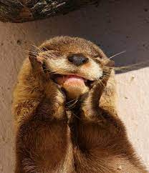
Study hard and do you best.
Good luck!!

